Slide 1
Class and Objects

Slide 2
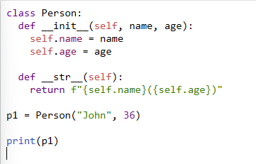
The Functions
The __init__() - which is always executed when the class is being initiated.
The __str__() function controls what should be returned when the class object is represented as a string.

Slide 3
The self Parameter
The self parameter is a reference to the current instance of the class, and is used to access variables that belong to the class.
It does not have to be named self, you can call it whatever you like, but it has to be the first parameter of any function in the class:

Slide 4
Modify Object Properties
p1.age = 40
del p1.age
Delete the p1 object:
del p1

Slide 5
Inheritance
Наследовать, унаследовать

Slide 6
Inheritance
Inheritance allows us to define a class that inherits all the methods and properties from another class.
Parent class is the class being inherited from, also called base class.
Child class is the class that inherits from another class, also called derived class.

Slide 7
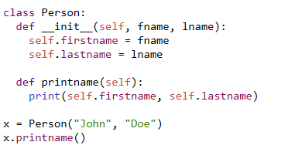
Create a Parent Class
Create a class named Person, with firstname and lastname properties, and a printname method:

Slide 8

Create a Child Class
To create a class that inherits the functionality from another class, send the parent class as a parameter when creating the child class:
Notes:
To create a class that inherits the functionality from another class, send the parent class as a parameter when creating the child class:

Slide 9
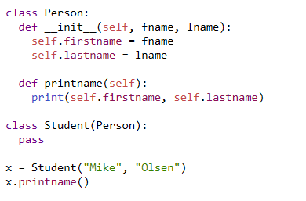
Notes:
Use the Student class to create an object, and then execute the printname method:

Slide 10


Add the __init__() Function
Notes:
So far we have created a child class that inherits the properties and methods from its parent.
We want to add the __init__() function to the child class (instead of the pass keyword).

Slide 11

super() Function
Python also has a super() function that will make the child class inherit all the methods and properties from its parent:
Notes:
By using the super() function, you do not have to use the name of the parent element, it will automatically inherit the methods and properties from its parent.

Slide 12

Add Properties
Add a property called graduationyear to the Student class:
In the example below, the year 2019 should be a variable, and passed into the Student class when creating student objects.

Slide 13
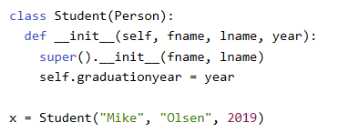

Slide 14
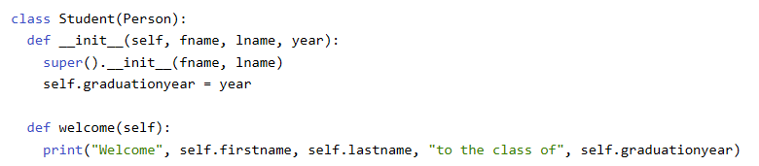
Add Methods
Add a method called welcome to the Student class:

Slide 15
Задание: Работа с наследованием классов
Создание иерархию классов с использованием наследования в Python
базовый класс, создадут подклассы

Slide 16
Инструкция
Создайте базовый класс Vehicle (Транспортное средство)
Атрибуты: brand (марка), model (модель), year (год выпуска)
Метод display_info(): выводит информацию о транспортном средстве
Создайте два подкласса:
Car (наследуется от Vehicle)
Дополнительный атрибут: num_doors (количество дверей)
Переопределяет display_info(), добавляя информацию о дверях
Motorcycle (наследуется от Vehicle)
Дополнительный атрибут: has_sidecar (есть ли коляска, булево значение)
Переопределяет display_info(), добавляя информацию о наличии коляски

Slide 17

3. Создайте экземпляры классов и протестируйте код:
Создайте объект Car и объект Motorcycle
Вызовите метод display_info() для каждого объекта

Slide 18
Class work

